Slide 1

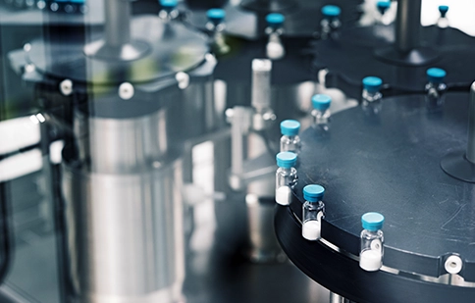

Life Sciences - Pharmaceuticals
Global MES Support Transformation for Client
Accenture modernized and unified Client’s highly fragmented PAS‑X MES landscape across 34 global sites by establishing a centralized, ITIL‑aligned support model. The engagement strengthened production reliability, reduced operational dependency, and enabled scalable MES lifecycle management across the global network.
Business Problem
Value Delivered
Client operated 34 Körber PAS‑X MES systems spread across multiple countries, each running different versions, customizations, and languages, which created significant fragmentation and operational inconsistency. MES support processes were not standardized, and most sites relied on independent local vendors, resulting in variable SLAs and slower issue resolution. The client was highly dependent on Körber for complex problem tickets, major upgrades, and hotfix installations, leading to increased cost and longer turnaround times. Additionally, BI lacked the necessary expertise in the newer PAS‑X V3.3 containerized Linux/Kubernetes‑based architecture, causing delays in diagnosing and resolving issues. Overall, this environment elevated operational risk and impacted production continuity across BI’s global plants.
Accenture delivered a unified, ITIL‑aligned MES support framework that eliminated siloed site‑level operations and improved MES stability across BI’s manufacturing network. The standardized model enabled consistent triaging, improved visibility into global MES performance, and strengthened production reliability. This transformation also streamlined upgrades, reduced operational delays, and increased compliance readiness across all sites.
The program resulted in zero MES downtime, ensuring uninterrupted production across critical operations. Critical incident volume decreased by ~30%, driven by improved triaging, global standardization, and upgraded PAS‑X templates. Overall MES support productivity increased by ~15% year‑over‑year, reducing both effort and cost through automation and optimized support workflows.
<Add Relevant Image>
Major Challenges & Financial Impact:
34 PAS‑X MES systems (multi‑version, multi‑language)
~10% potential demurrage cost reduction identified
30% critical‑incident reduction achieved through standardization
Limited PAS‑X V3.3 (Kubernetes) expertise internally
Zero automation for incident / problem analysis
Siloed support model with inconsistent SLAs
Key results included:
Zero downtime for MES users, the unified support model and proactive monitoring eliminated production interruptions across all 34 PAS‑X sites. Standardized processes and improved service governance ensured predictable system behavior and uninterrupted manufacturing operations.
30% reduction in critical incidents, achieved through expert triaging, harmonized templates, faster root‑cause isolation, and consistent L1.5–L3 support across all regions. This significantly reduced high‑severity escalations and improved MES stability.
15% year‑over‑year productivity improvement, stemming from ticket elimination, increased automation, optimized support staffing, and reduced dependency on Körber. This lowered support effort and improved overall MES cost efficiency for BI.
Solution Insights
Accenture introduced a hybrid global support model that combined ITIL‑driven governance with 24×7 expert MES operations across all BI sites. Approximately 40% of the team focused on standardizing processes, compliance, monitoring, KPI reporting, and vendor coordination, while the remaining 60% provided centralized L1.5–L3 PAS‑X support in English, German, and Spanish. The team took ownership of all PAS‑X installations, upgrades, DR management, and template enhancements, significantly reducing dependency on Körber. Accenture also enabled seamless support of the PAS‑X V3.3 Kubernetes‑based architecture, bringing specialized platform knowledge into BI’s operating model.

